Slide 1
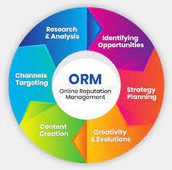
Online Reputation Management
Online reputation management (ORM) means monitoring and improving online presence of your business. ORM helps us to understand and improve how your business is perceived online. To put in other words, it is understood and analyzing what a potential customer or partner will think about your brand/ people/ product/ service on the internet. The main thing behind ORM is to understand whether your online presence working for or against you.

Slide 2


Importance Of Having A Positive Online Reputation
It boosts sales: A positive online reputation will help you in increasing sales. By seeing positive reputation other people will start buying your product.
It helps in building a brand image: If a negative information about a brand is shared on the internet, than a customer’s loyalty gets ruined. The respect earned by company go to waste within a blink of an eye. So positive online reputation must be needed by a company.
Builds trust and credibility: Trust is very vital for any business. People usually buy products only from whom they trust. No one can buy from whom they do not trust. Trust gives company a long life.
Serves as a powerful marketing tool: When a customer finds that your services is best as compared to your competitors, the customer becomes yours forever and they can become an advocate for your products and services by sharing their experiences on review sites and social media.

Slide 3



Consequences Of Negative Online Reputation
Loss of revenue: According to the research, bad reviews on Google, Social media have a significant effect on revenues. A business with a 1-1.5 star rating reports less revenue than the average enterprise. Forbes reports that 94% of customers avoid a company with bad reviews.
Harm business reputation: Negative reviews have the power to damage the reputation of the company which they built for years. Customers do not purchase product or services from a store with a bad reputation. Abundant negative reviews are hard to fix, making it challenging to regain consumers’ trust.
Drive customers away: Negative reviews succeed in chasing away your customers to your competitors. The percentage of lost customers increases with an increase in negative reviews.
Decrease profitability: Negative reviews decrease profitability of the company by driving away their customers and decreases revenue.

Slide 4

How to grow, manage, and repair online reputation
Broaden your internet presence: Twitter, Facebook, and Instagram are the three big social media platforms. There are dozens of other social sites available. You want to look into as a way to expand your digital footprint.
Pay attention to your social media accounts: Having multiple social media accounts for your business is not enough to manage your online reputation. Its important to regularly maintained in order to garner an organic followers. By your continuous presence in social media it will boost your engagement and have opportunity to interact with current and potential customers.
Generate and respond to online reviews: One of the best technique to build up your business’ online reputation is let your happy clients and customers build it for you through by giving good online reviews. According to the survey, a massive people read online reviews for businesses before deciding to make a purchase.
Listen your customers: When responding to negative customer feedback, it is important to consider it. There may be some validity to the comments being made. This is especially true, if you are getting frequently negative reviews.
Invest in online reputation management: Establishing your online reputation management requires an investment of both time and money. Many small businesses neglect to proactively manage their online reputation until there is a problem that needs to addressed.

Slide 5

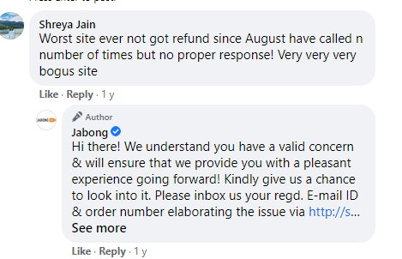
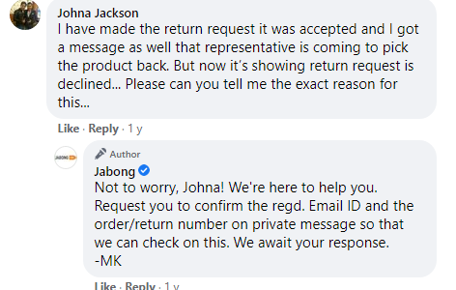

Slide 6

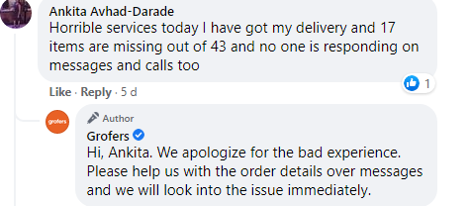
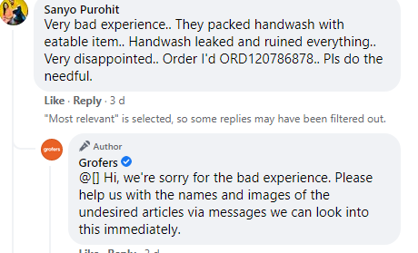

Slide 7

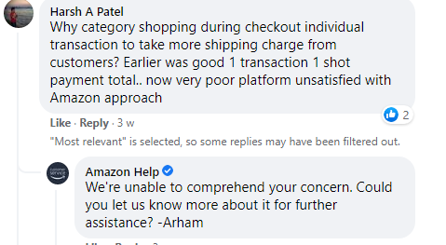
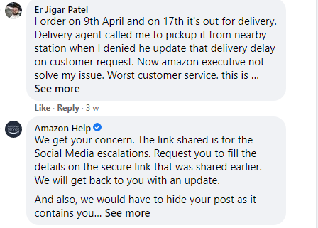

Slide 8

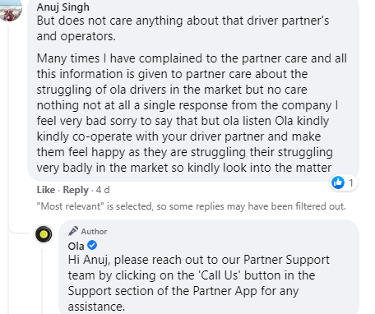
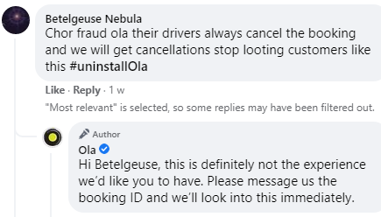

Slide 9

